Slide 1
Network Theory: Balance

Slide 2
Triadic processes
Triadic configurations exhibit properties not reducible to (but still dependent on) dyadic processes (Simmel 1908)
  "Simplest" configuration that exhibit "group" properties (e.g. factionalization, alliance formation, brokerage, etc.)
A series of social network theories rely on triadic processes:
  Structural Balance Theory
  Granovetter's "Strength of Weak Ties" (SWT) theory
  Power-Dependence Exchange Theories
  Brokerage Theories
  Simmelian Dyad Theory
  Structural Holes (SH) Theory

Slide 3
Triadic processes
Link between micro-processes and macro-signatures of complex networks
  Micro-process: "friends of friends become friends."
  Macro-signature: Number of fully connected triples deviates significantly from that characteristic of random networks
This has implications for:
  Diffusion dynamics within networks
  Overall cohesion within the social structure (e.g. community structure)
  Brokerage and information control opportunities
  Innovation and the generation of novel ideas

Slide 4
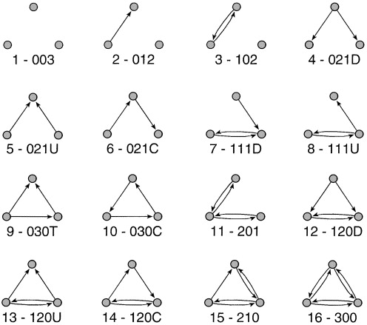
The triad census: Directed Graph
Extraction of every distinct subgraph of order = 3
If the graph is directed the size of these subgraphs ranges from: 0 to 6.
Counting the prevalence in a whole network of each of these 16 configurations (“motifs”) gives insight into the overall structure of the network

Slide 5
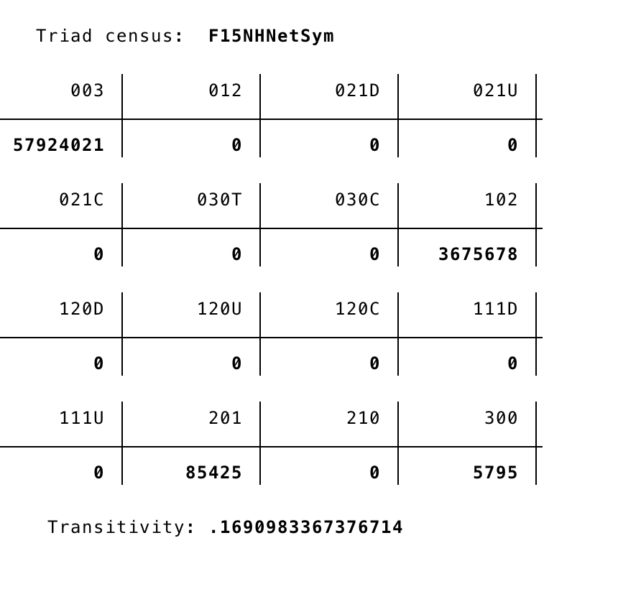
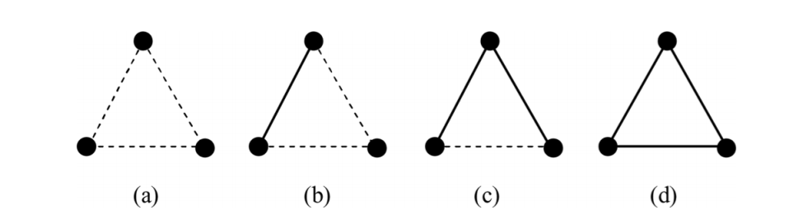
Triadic Census: Undirected Graph
4 configurations: Null, Dyad, 2-path,, Triangle
Consider the dotted line either a negative tie, or the absence of a tie
Which configurations are more prevalent? Which are rare?
003
102
201
300

Slide 6

Transitivity
Transitivity is the key index of triadic structure
Akin to mathematical transitivity; relation R is transitive iff:
    aRb, and bRc jointly imply aRc
    Equality, Less than, Greater than, etc.
Same reasoning applies to social relationships

Slide 7
Global measures of transitivity
A simple way to quantify the level of transitivity in a network is to think of it as a probability
  In this case, it is the conditional probability that (for any three vertices u, w, v):
    If we observe the uw edge and the uv edge,
    We will also observe the wv edge
  Note that condition (i) defines a path of length 2
  So a way to quantify transitivity in the network is simply to:
    Count all of the paths of length two
    Determine how many of them are closed
    Divide the last quantity by the first

Slide 8


Average Cluster Coefficient
Ego level (local) clustering coefficient
Average Local Clustering Coefficient = Local Transitivity
Global Transitivity: C = # closed triplets / Sum(closed + open)

Slide 9
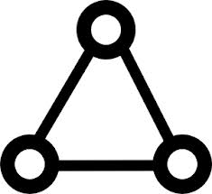

Edge Multiplicity
The degree dependent clustering coefficient is a vertex level index: The number of triangles (T_{i}) in which a vertex participates
We may ask the same question about a pair of vertices, defining an index of clustering for edges
The multiplicity of an edge m_{ij} can be defined as the number of triangles in which that edge participates.
The quantities are related as:

Slide 10
Random Graph
How many triangles would you expect to find in a random graph?
  They will be relatively rare
So why in a non-random graph are there more triangles than expected in a random graph?
  Why are there fewer “two-path” triadic configurations?
Many explanations - theories
Structural Balance Theory

Slide 11

Structural balance theory
Building blocks
  A set of actors
  A set of (signed) relationships defined on those actors
  For example: Likes and Dislikes

Slide 12
Structural balance theory
Considering triads containing directional arcs
  This is the key to balance theory
    Solid lines are positive sentiments
    Null (dashed) lines are negative sentiments

Slide 13
Structural balance theory
In structural balance theory, each vertex in the configuration is given a designation
  Person (P): "The individual whose behavior is being predicted by the theory" (Davis 1963: 445).

Slide 14
Structural balance theory
In structural balance theory, each vertex in the configuration is given a designation
  Other (O): An object (e.g another individual) towards which P is oriented.

Slide 15
Structural balance theory
In structural balance theory, each vertex in the configuration is given a designation
  Q: A third object (a value, group or another individual) towards which P and O are oriented.

Slide 16
Structural balance theory
The basic premise of the theory is that people are motivated to seek balance in the triadic configurations in which they are embedded.

Slide 17
Structural balance theory
Balance is formally defined as the sign of the product of the weights attached to each edge in the cycle.
  Positive triads are balanced
  Negative triads are imbalanced

Slide 18
Structural balance theory
PQ |  | OQ |  | PO |  | POQ

Slide 19
Structural balance theory
Balance is formally defined as the sign of the product of the weights attached to each edge in the cycle.
  Balance reduces “tension” and is experienced as satisfactory (stable equilibrium)

Slide 20
Structural balance theory
Balance is formally defined as the sign of the product of the weights attached to each edge in the cycle.
  Imbalance is experienced as tension and discomfort (unstable state) that must be resolved (balanced)

Slide 21

Structural balance theory
Balance is formally defined as the sign of the product of the weights attached to each edge in the cycle.
  Imbalance is experienced as tension and discomfort (unstable state) that must be resolved (balanced)

Slide 22
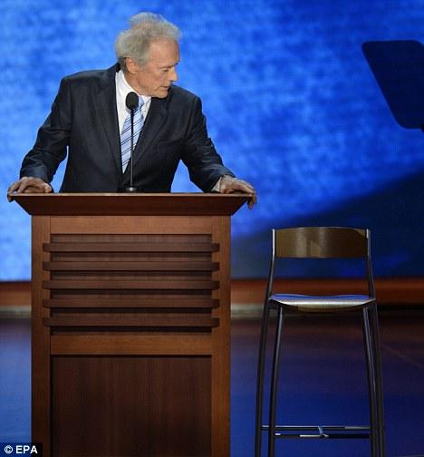
Structural balance theory
Balance is formally defined as the sign of the product of the weights attached to each edge in the cycle.
  Imbalance is experienced as tension and discomfort (unstable state) that must be resolved (balanced)
Republican Party
You
Clint Eastwood

Slide 23
Structural balance theory
Balance is formally defined as the sign of the product of the weights attached to each edge in the cycle.
  Imbalance is experienced as tension and discomfort (unstable state) that must be resolved (balanced)
Taxes
Americans
Public Education

Slide 24
Structural balance theory
Balance "rules"
  If P likes O, and O likes Q, P likes Q
  If P likes O, and O dislikes Q, P dislikes Q
  If P dislikes O, and O likes Q, P dislikes Q
  If P dislikes O and O dislikes Q, P likes Q

Slide 25
Structural balance theory
Balance "rules"
  If P likes O, and O likes Q, P likes Q
  If P likes O, and O dislikes Q, P dislikes Q
  If P dislikes O, and O likes Q, P dislikes Q
  If P dislikes O and O dislikes Q, P likes Q

Slide 26
Structural balance theory
Balance "rules"
  If P likes O, and O likes Q, P likes Q
  If P likes O, and O dislikes Q, P dislikes Q
  If P dislikes O, and O likes Q, P dislikes Q
  If P dislikes O and O dislikes Q, P likes Q

Slide 27
Structural balance theory
Balance "rules"
  If P likes O, and O likes Q, P likes Q
  If P likes O, and O dislikes Q, P dislikes Q
  If P dislikes O, and O likes Q, P dislikes Q
  If P dislikes O and O dislikes Q, P likes Q

Slide 28
Structural balance theory
Balance "rules"
  Friend of a friend is a friend
  Enemy of an Enemy is a friend
  Friend of an enemy is an enemy
  Enemy of a friend is an enemy
Can extend to non-signed binary relationships.

Slide 29

Structural balance theory
Considering relations of multiple others in relation to the same object can lead to more complex mixtures of balance and imbalance:
  The “cross-pressure” situation
Q

Slide 30
Structural balance theory
Cartwright and Harary (1956) proved that if all of the triads in a signed value matrix are balanced, then
  The matrix can be blocked into two mutually exclusive groups such that:
  All edges with positive weights are within blocks
  All edges with negative weights are between blocks.

Slide 31
Structural balance theory
This "structural balance" formalizes a key intuition between balance processes at the micro-level and macro-level group structure
  Balance seeking at the micro-level leads to group polarization at the macro-level

Slide 32

Structural balance theory
Q(liberal tweet)
P(liberal retweeter)
O(liberal tweeter)

Slide 33
Structural balance theory
This is a mathematically elegant result, but…
  Does structural balance hold in the real world?
Davis (1967) examined evidence on a large set of sociograms
  He found that triads (b) and (d) are over-represented and triad (c) is underrepresented
    But triad (a) is not underrepresented

Slide 34
Structural balance theory
This is a mathematically elegant result, but…
  Does structural balance hold in the real world?
Davis (1967) referred to such a distribution in which “enemies of enemies could be either friends or enemies” as generalized balance
  A relaxation of the stronger structural balance condition

Slide 35
Generalized balance
This is a mathematically elegant result, but…
  Does structural balance hold in the real world?
Under a generalized balance regime a graph can be partitioned into more than two clusters containing positive relations within and negative relations between

Slide 36
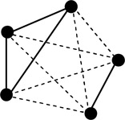
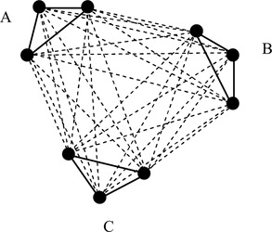
Generalized balance
This is a mathematically elegant result, but…
  Does structural balance hold in the real world?
Graph satisfying generalized balance may become “stuck” in a “jammed state”
  Here every sign change that increases balance for one triad makes it worse for everyone else

Slide 37
Generalized balance
Jammed states:
  "...represent situations in which divided loyalties obscure group boundaries" (van de Rijt 2011: 97-98)
  Suggest that the pursuit of structural balance at the micro-level does not necessarily result in generalized balance at the macro-level
  Having to satisfy multiple constraints prevents binary polarization

Slide 38
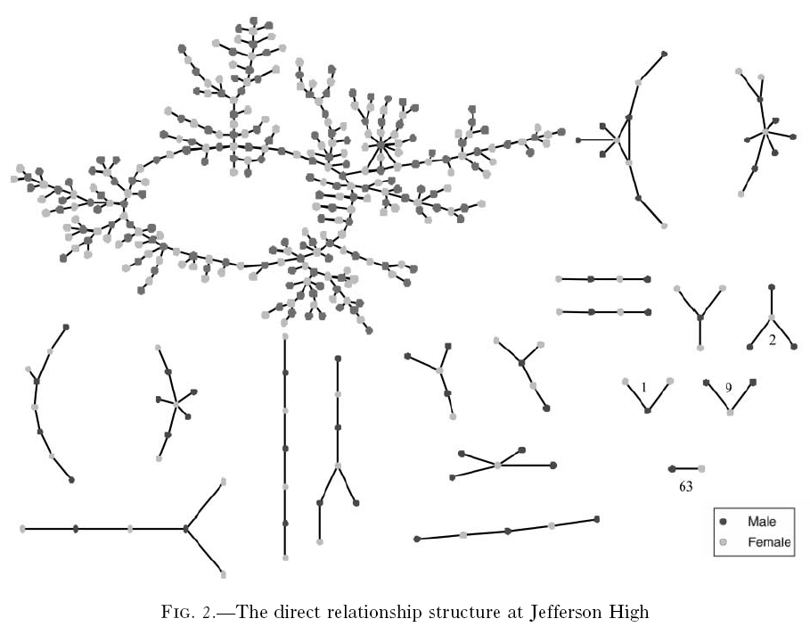
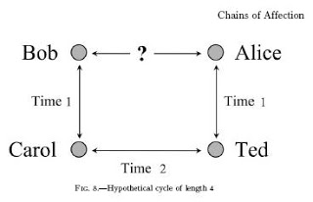
Beyond balance

Slide 39
Beyond balance

Slide 40
Beyond balance

